Slide 1
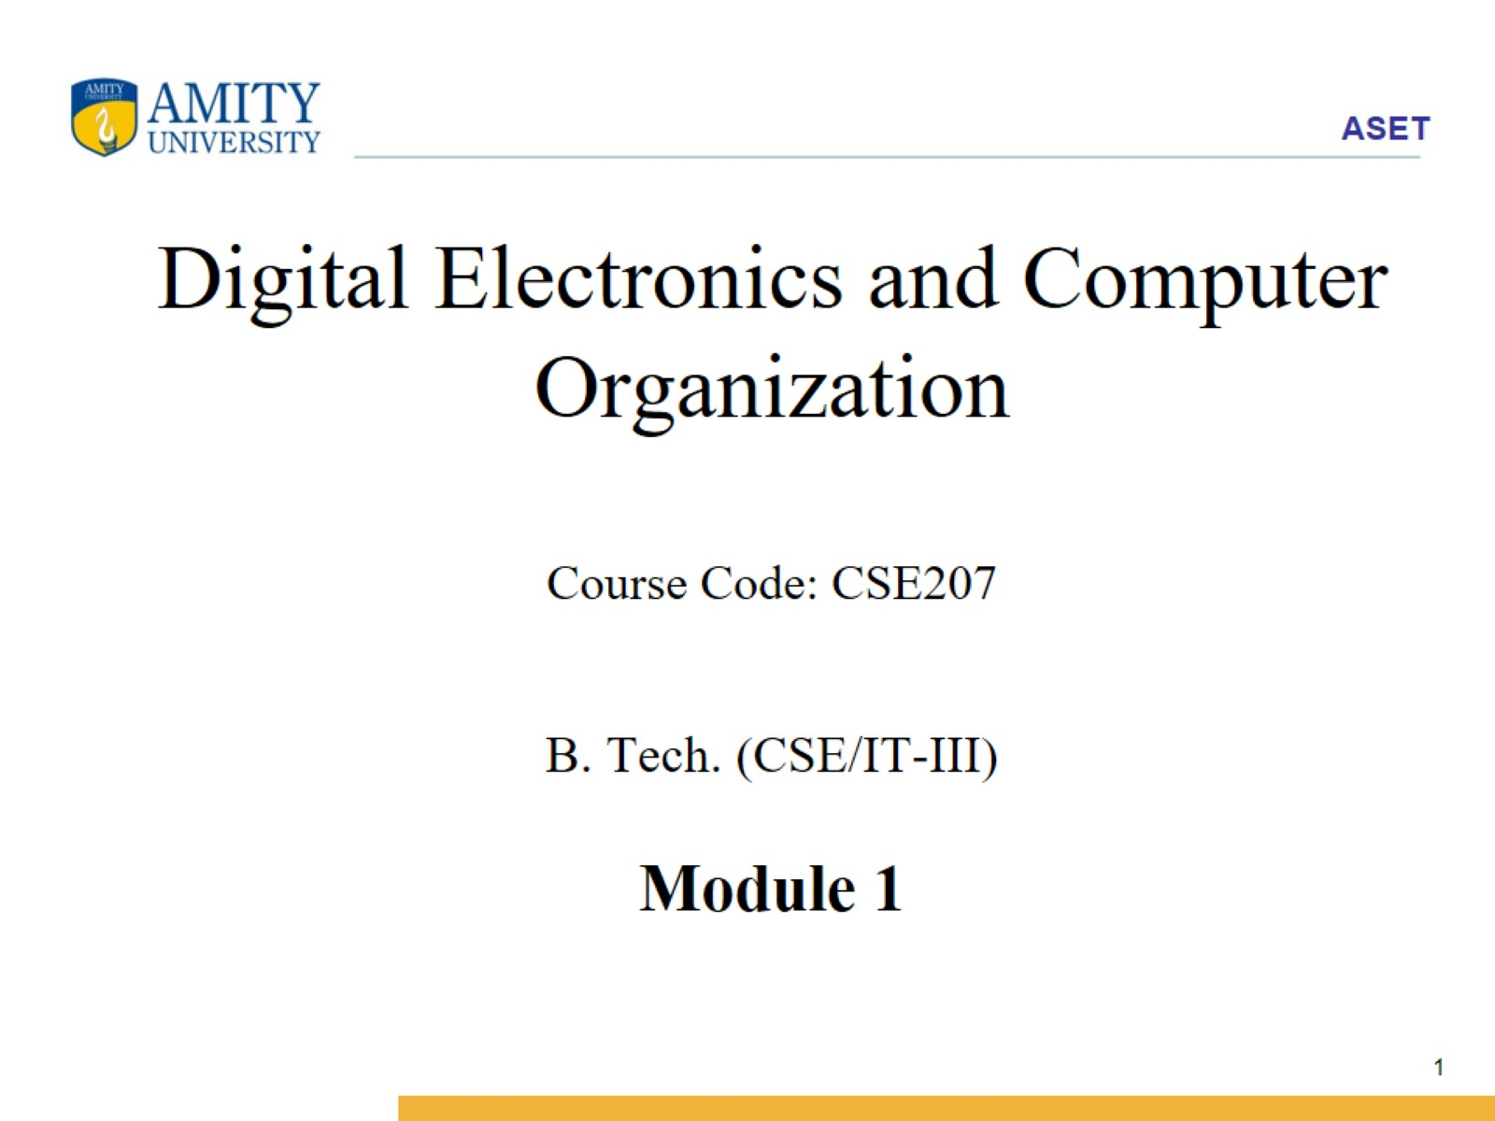
Digital Electronics and Computer Organization Course Code: CSE207 B. Tech. (CSE/IT-III) Module 1

Slide 2
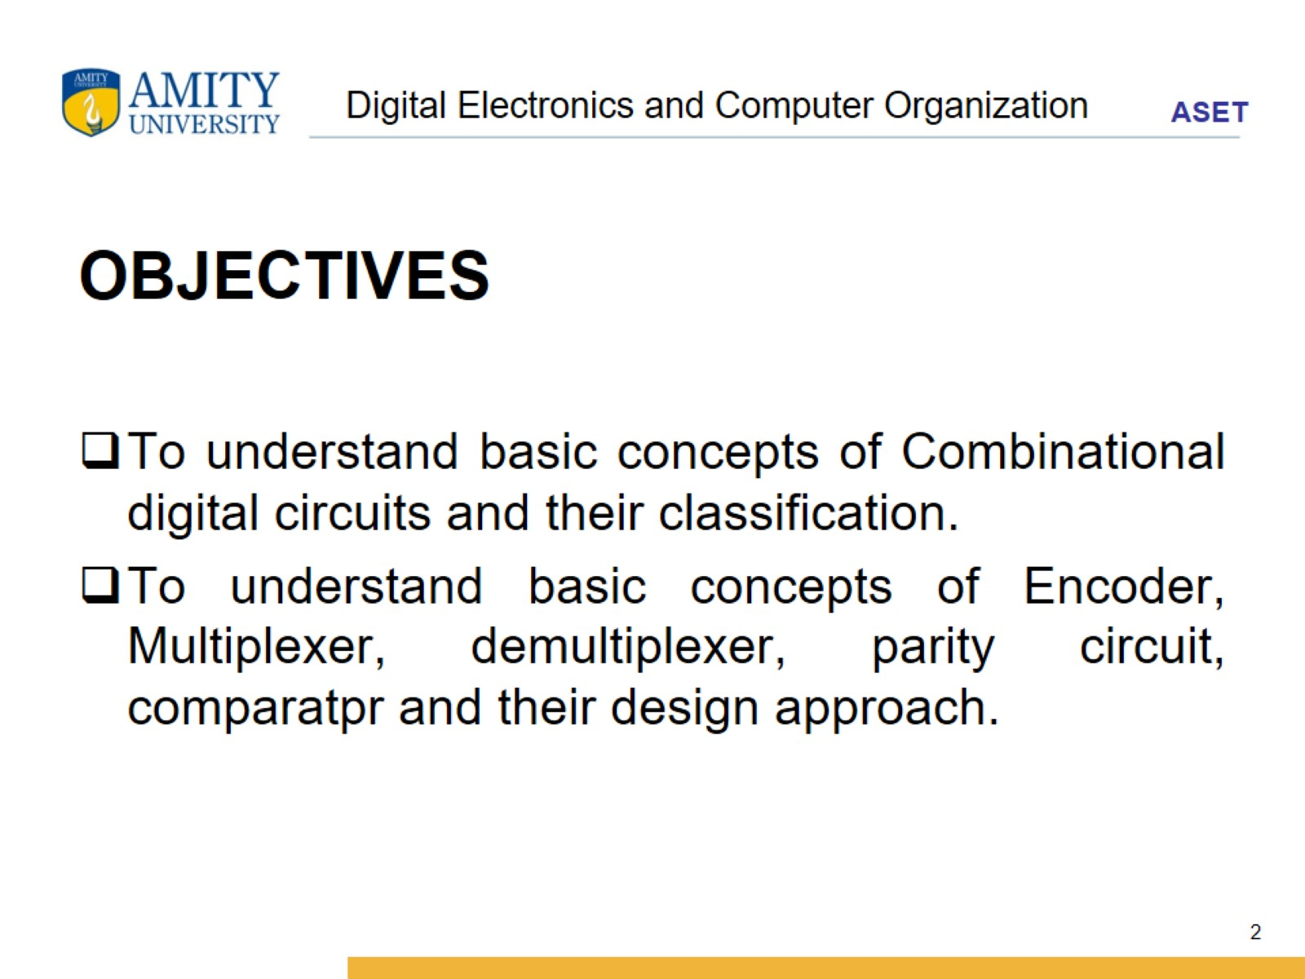
Digital Electronics and Computer Organization

Slide 3
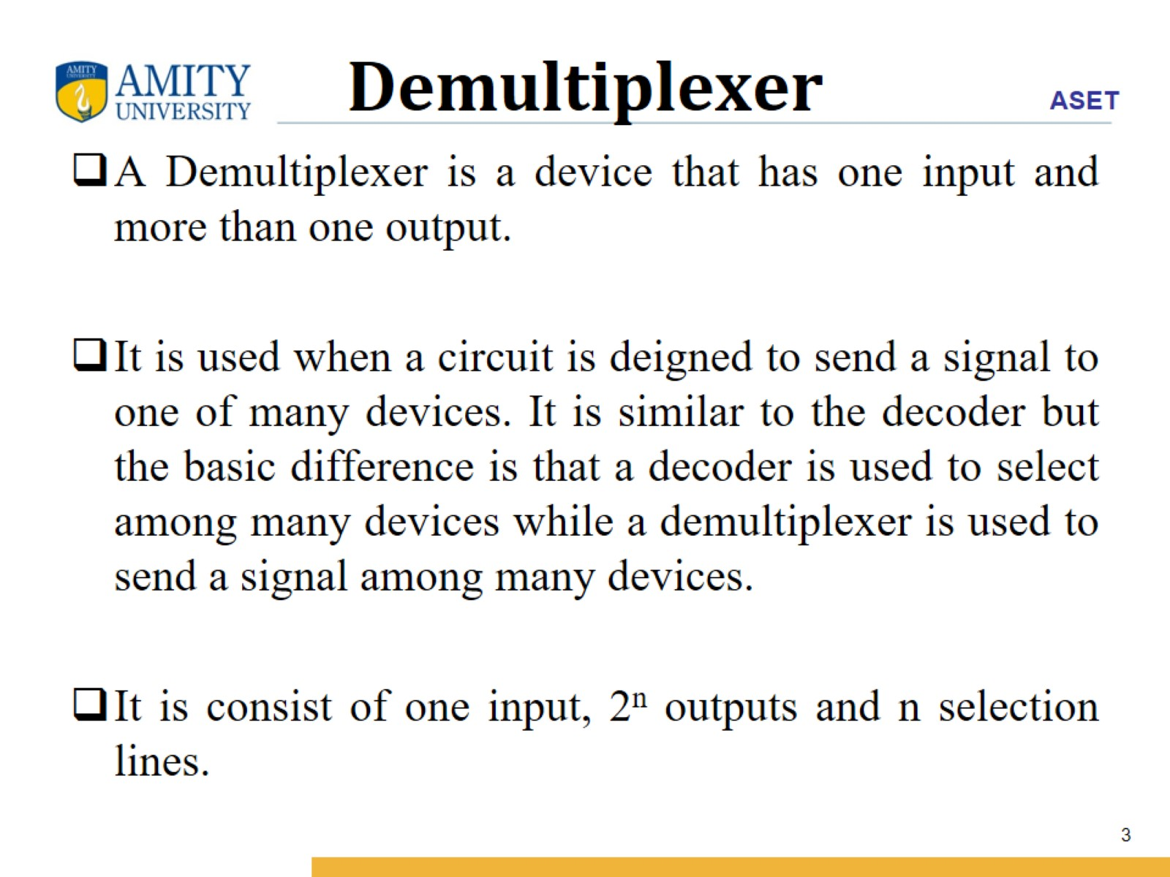
Demultiplexer

Slide 4
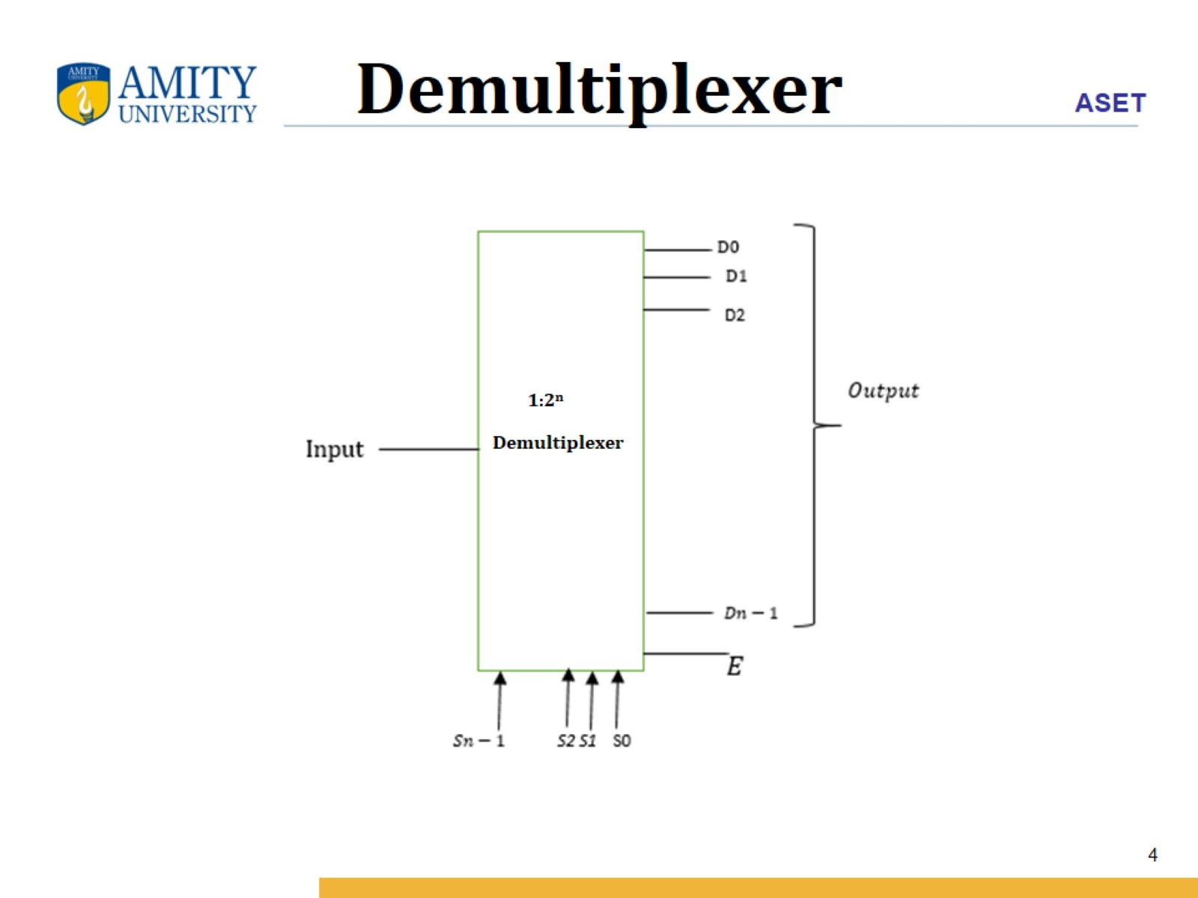
Demultiplexer

Slide 5
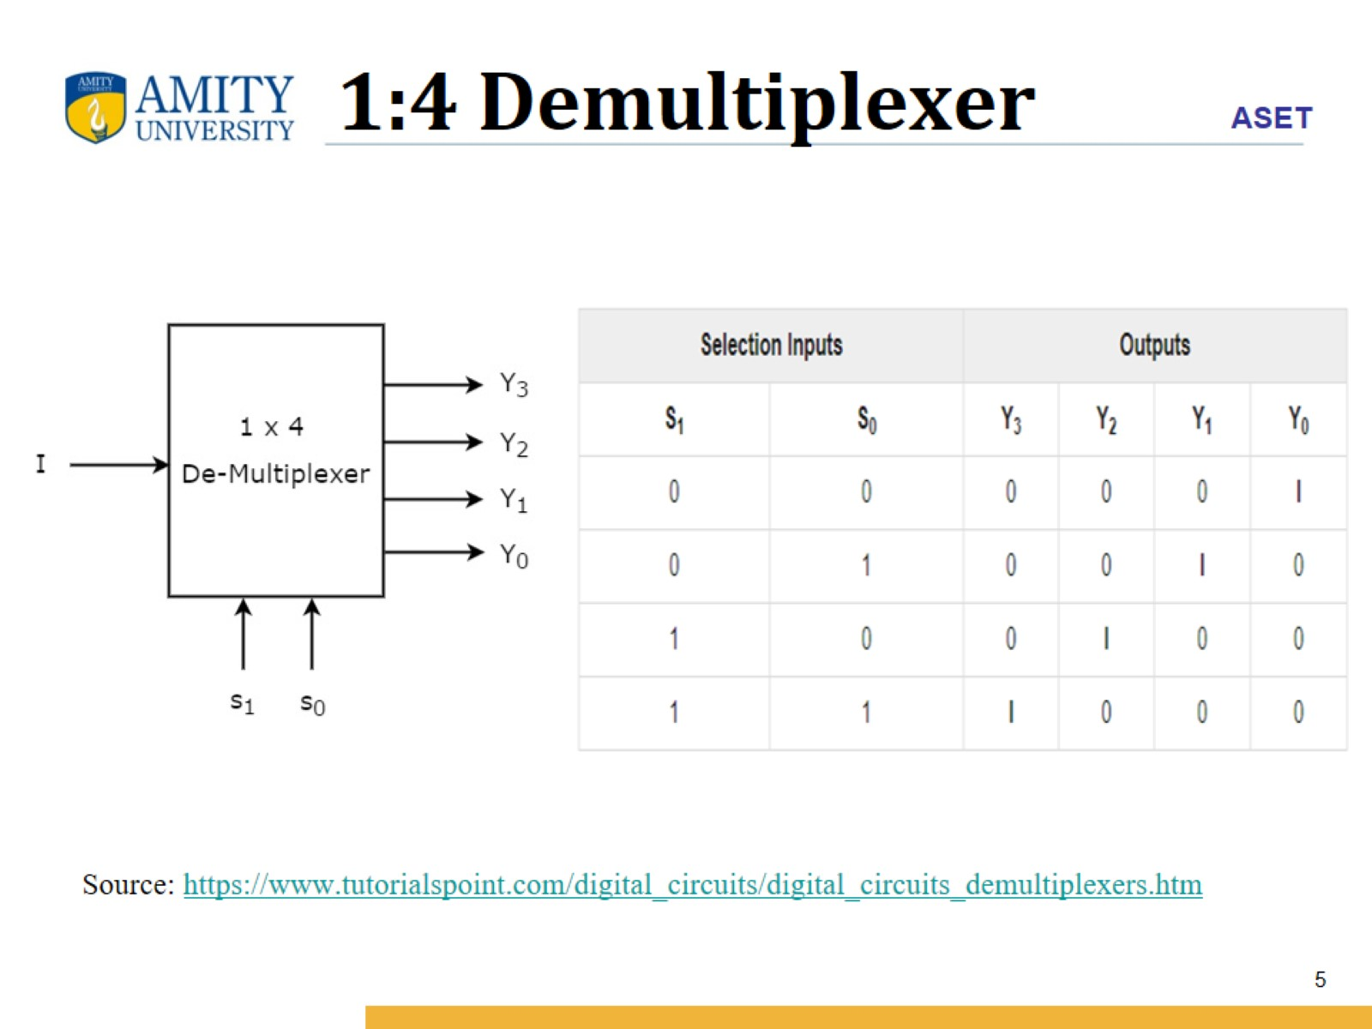
1:4 Demultiplexer

Slide 6
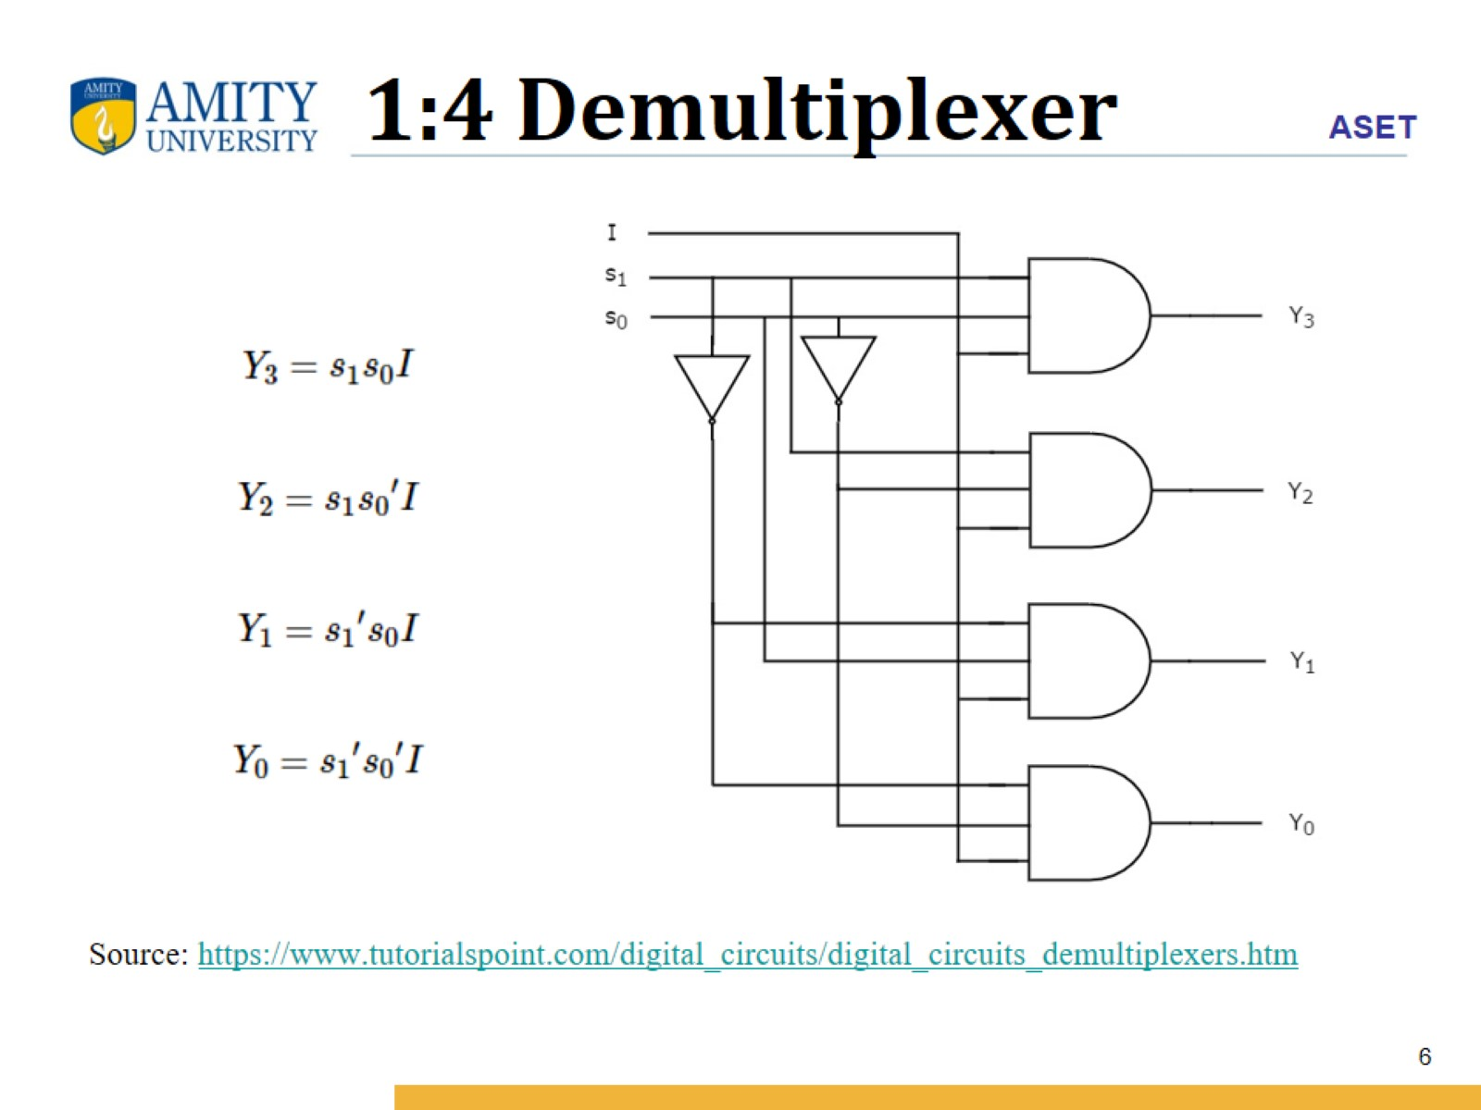
1:4 Demultiplexer

Slide 7
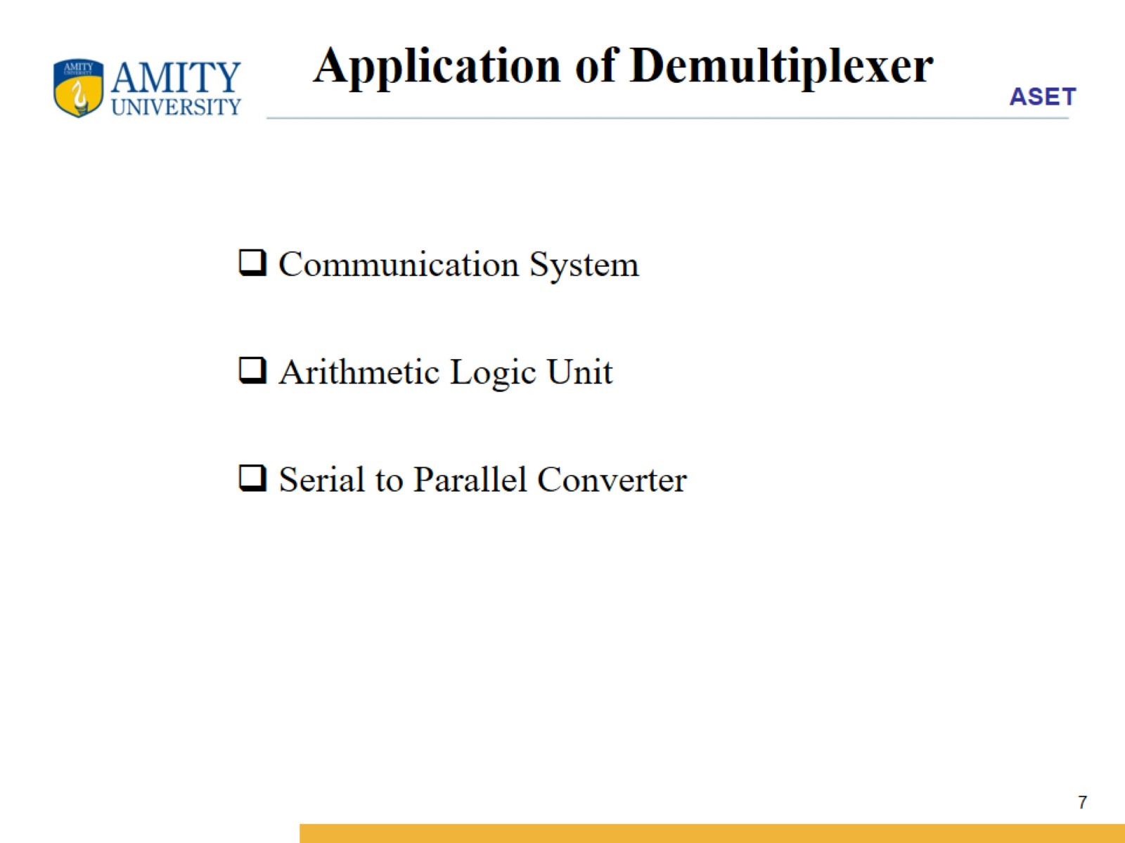
Application of Demultiplexer

Slide 8
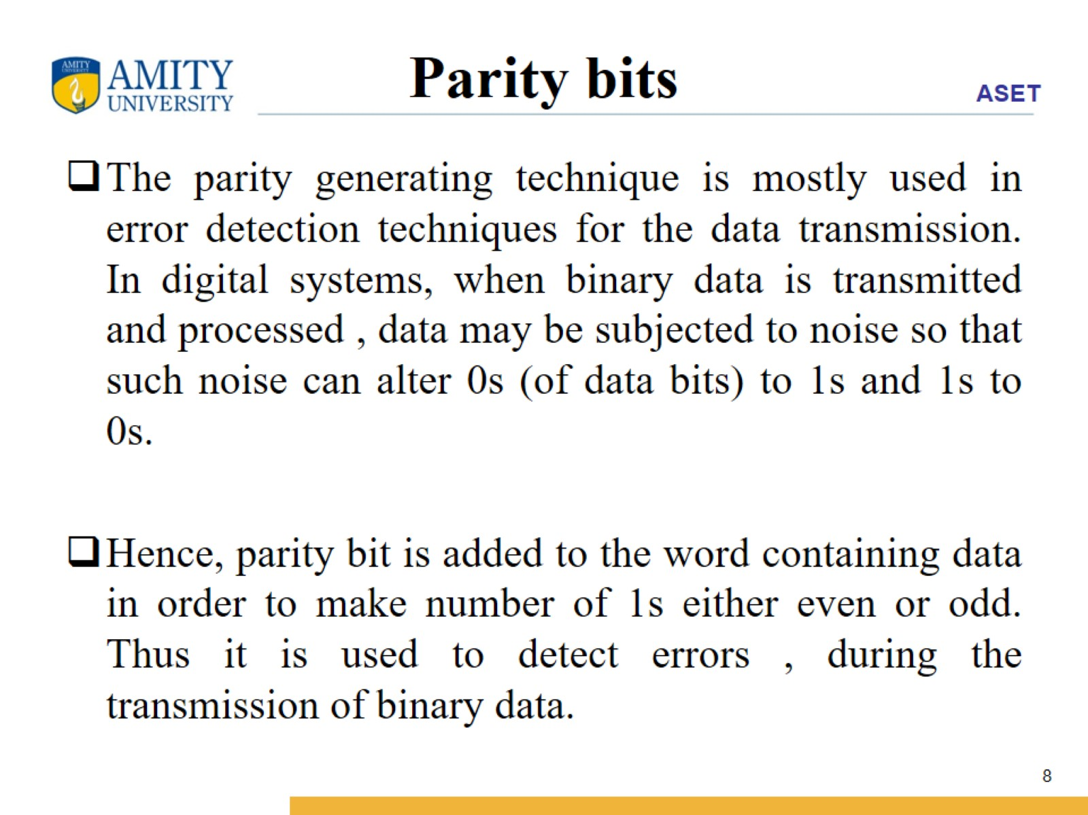
Parity bits

Slide 9
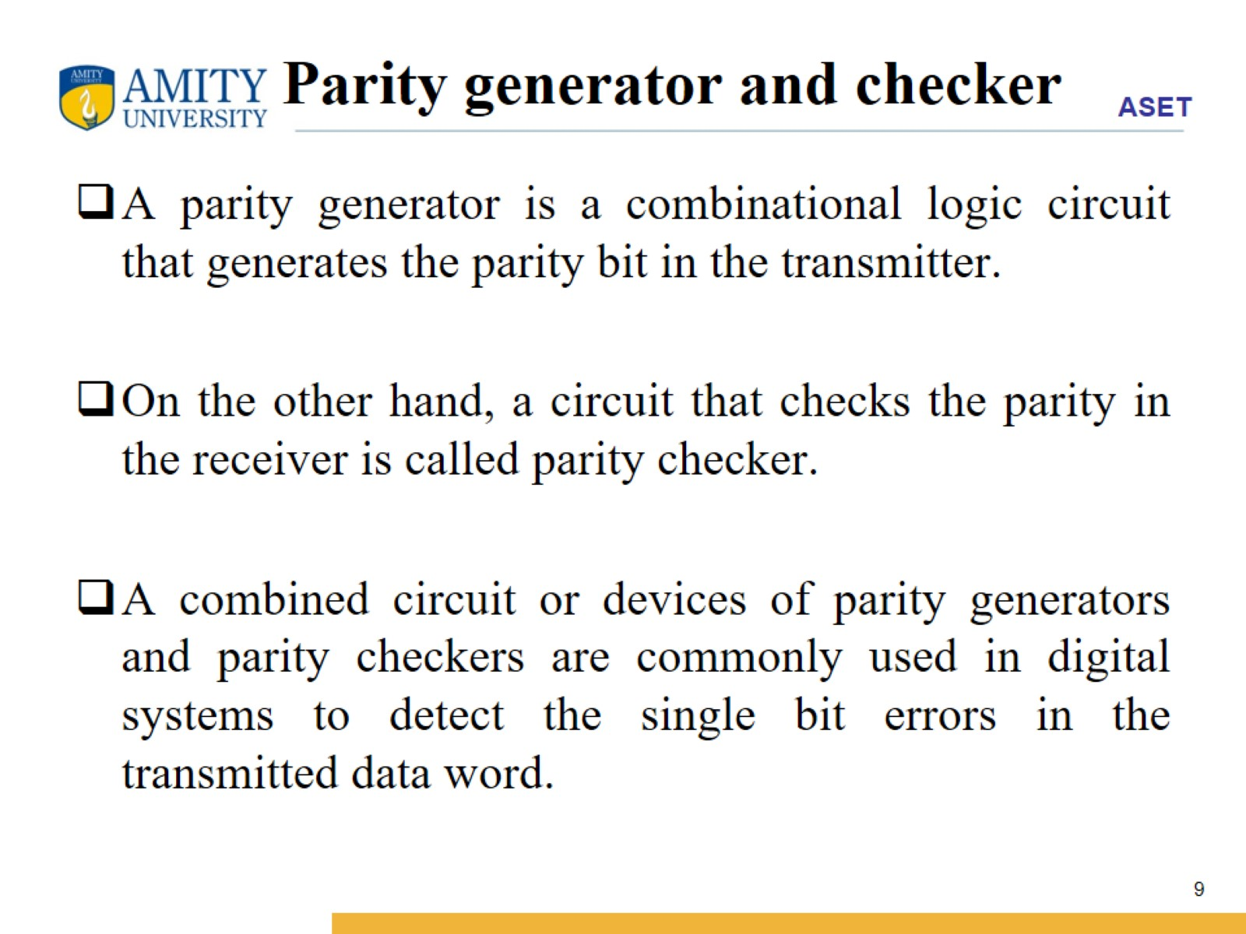
Parity generator and checker

Slide 10
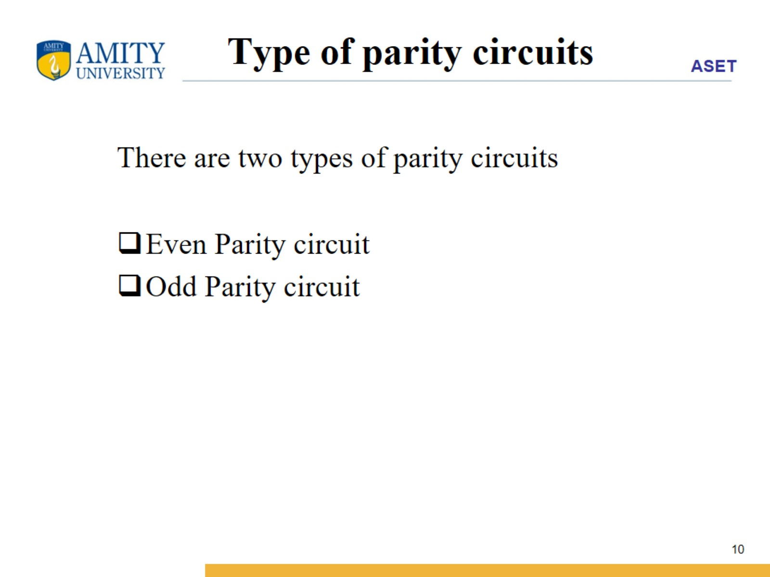
Type of parity circuits

Slide 11
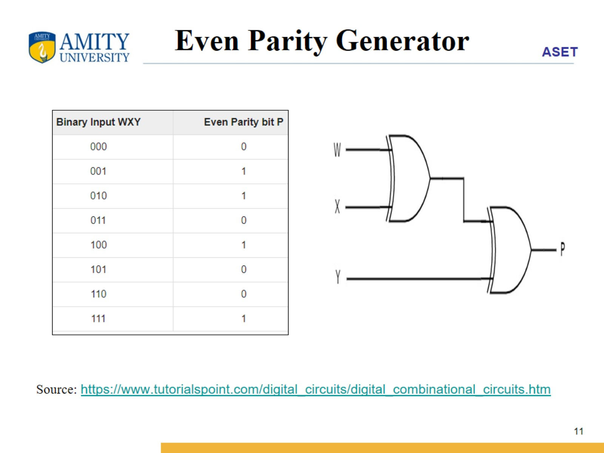
Even Parity Generator

Slide 12
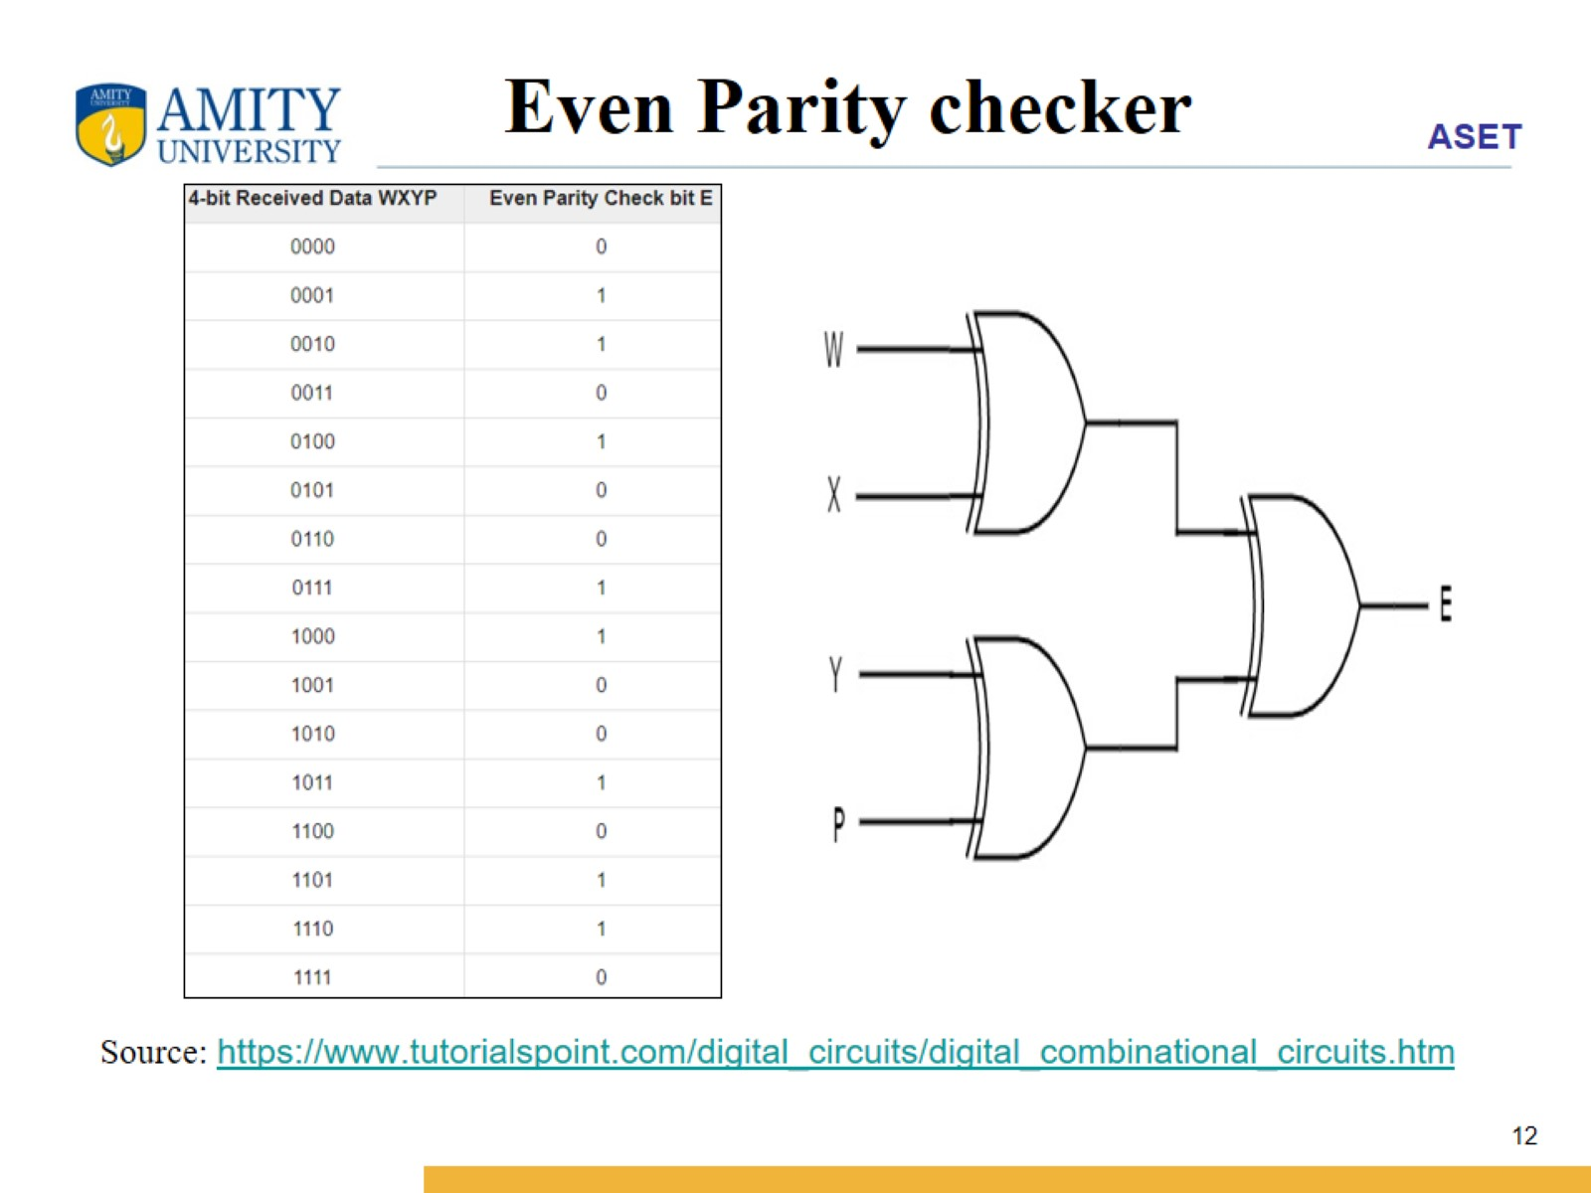
Even Parity checker

Slide 13
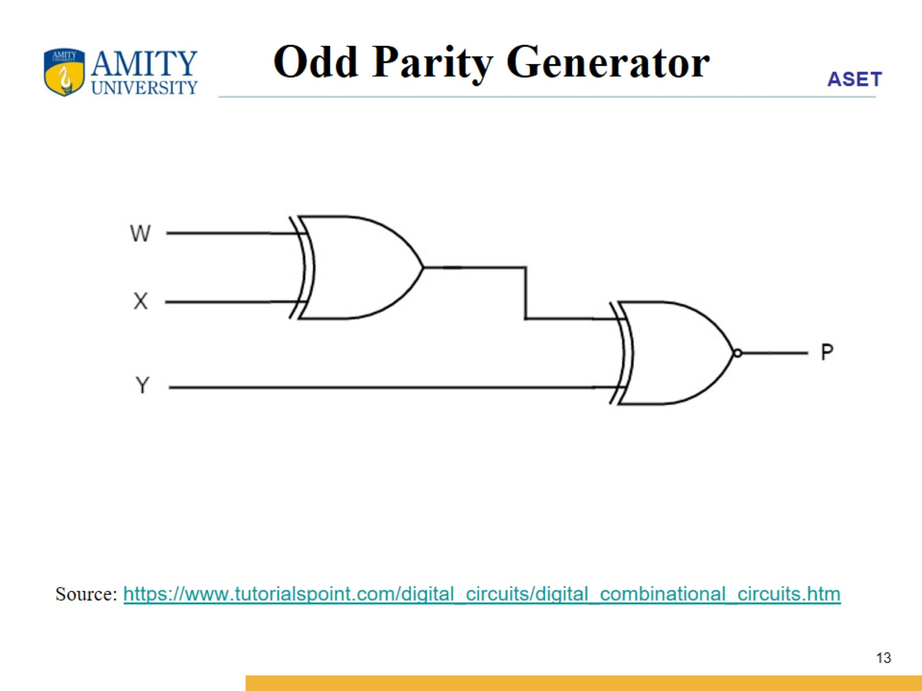
Odd Parity Generator

Slide 14
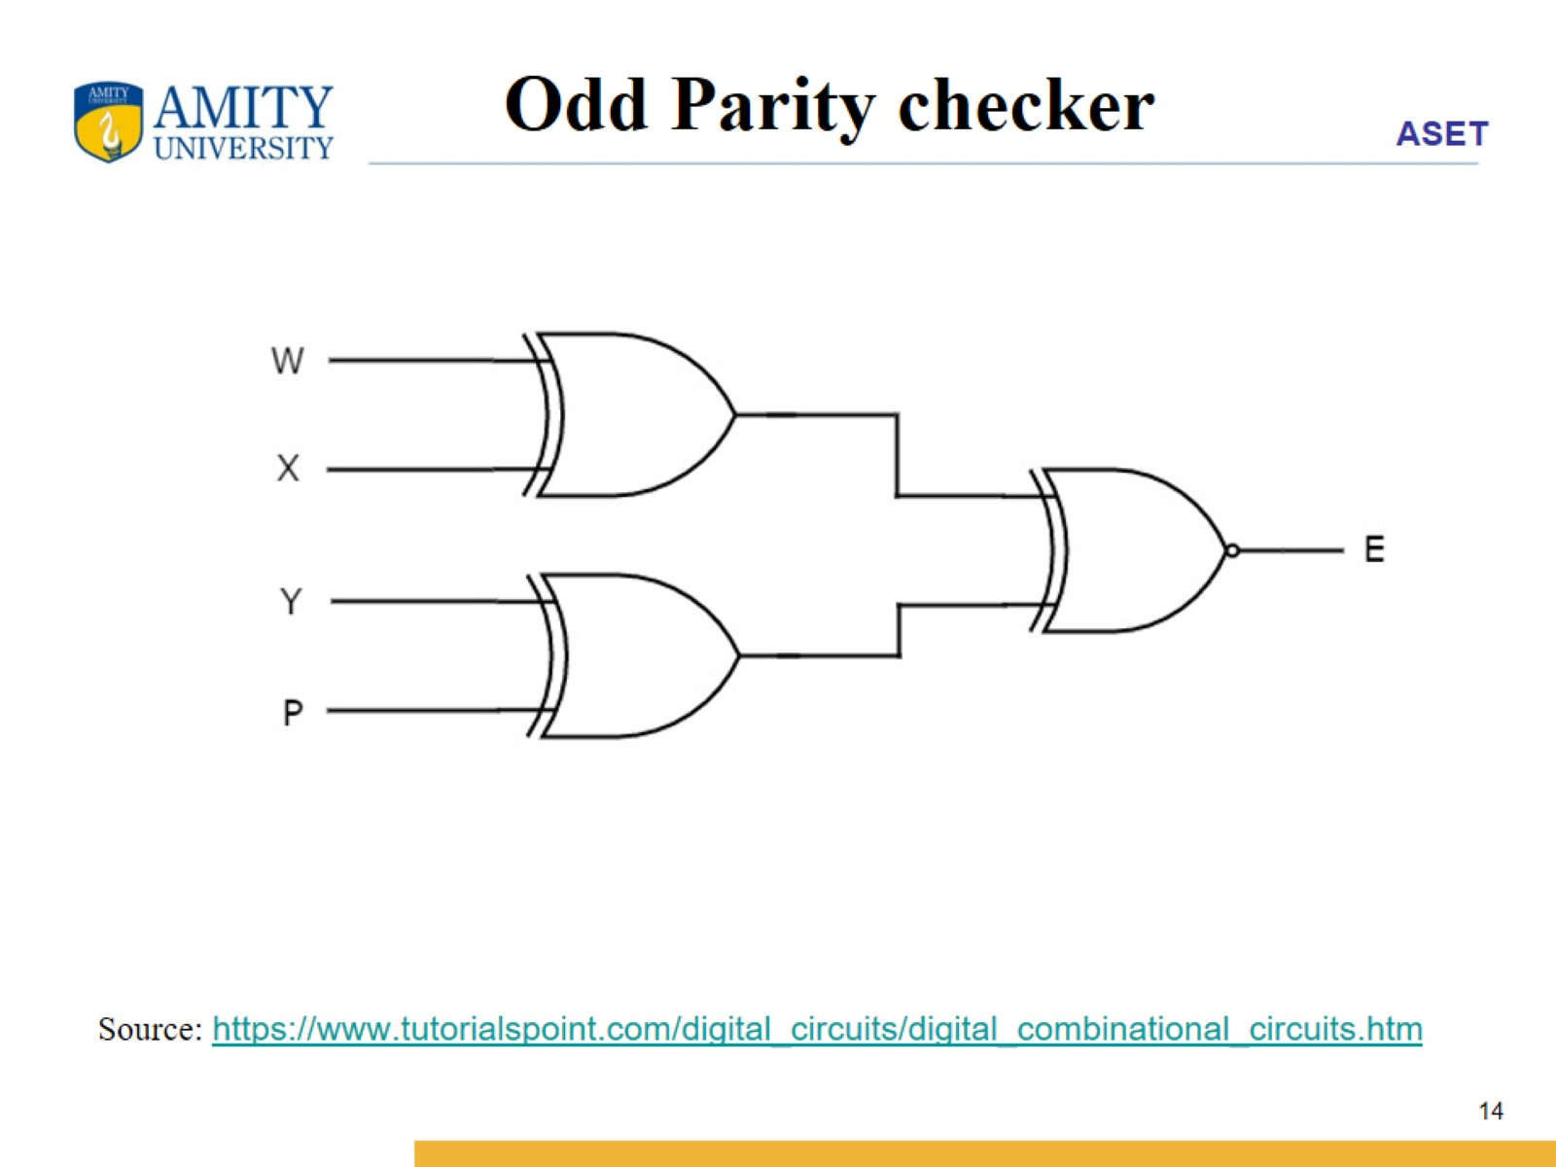
Odd Parity checker

Slide 15
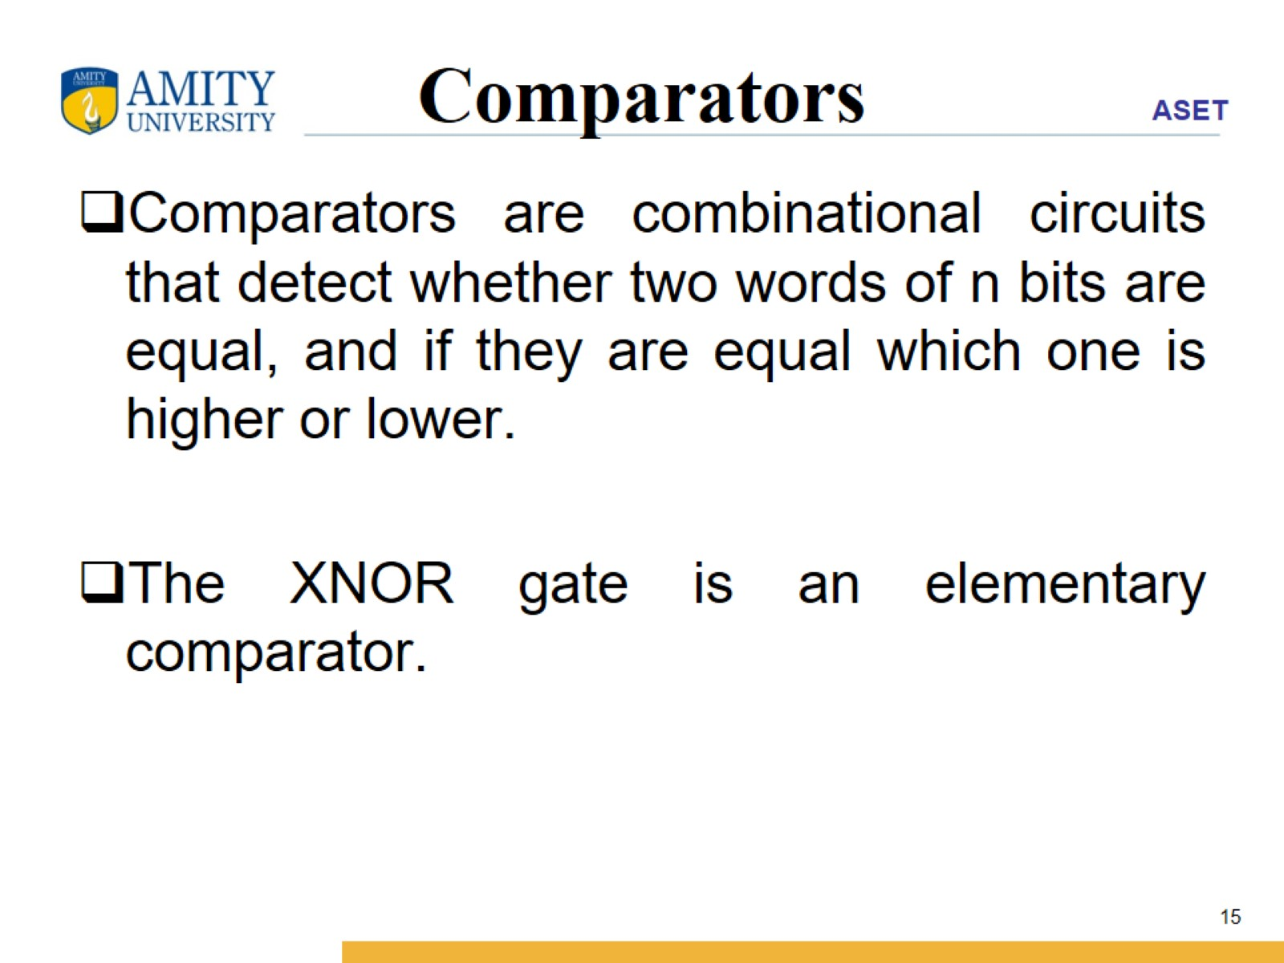
Comparators

Slide 16
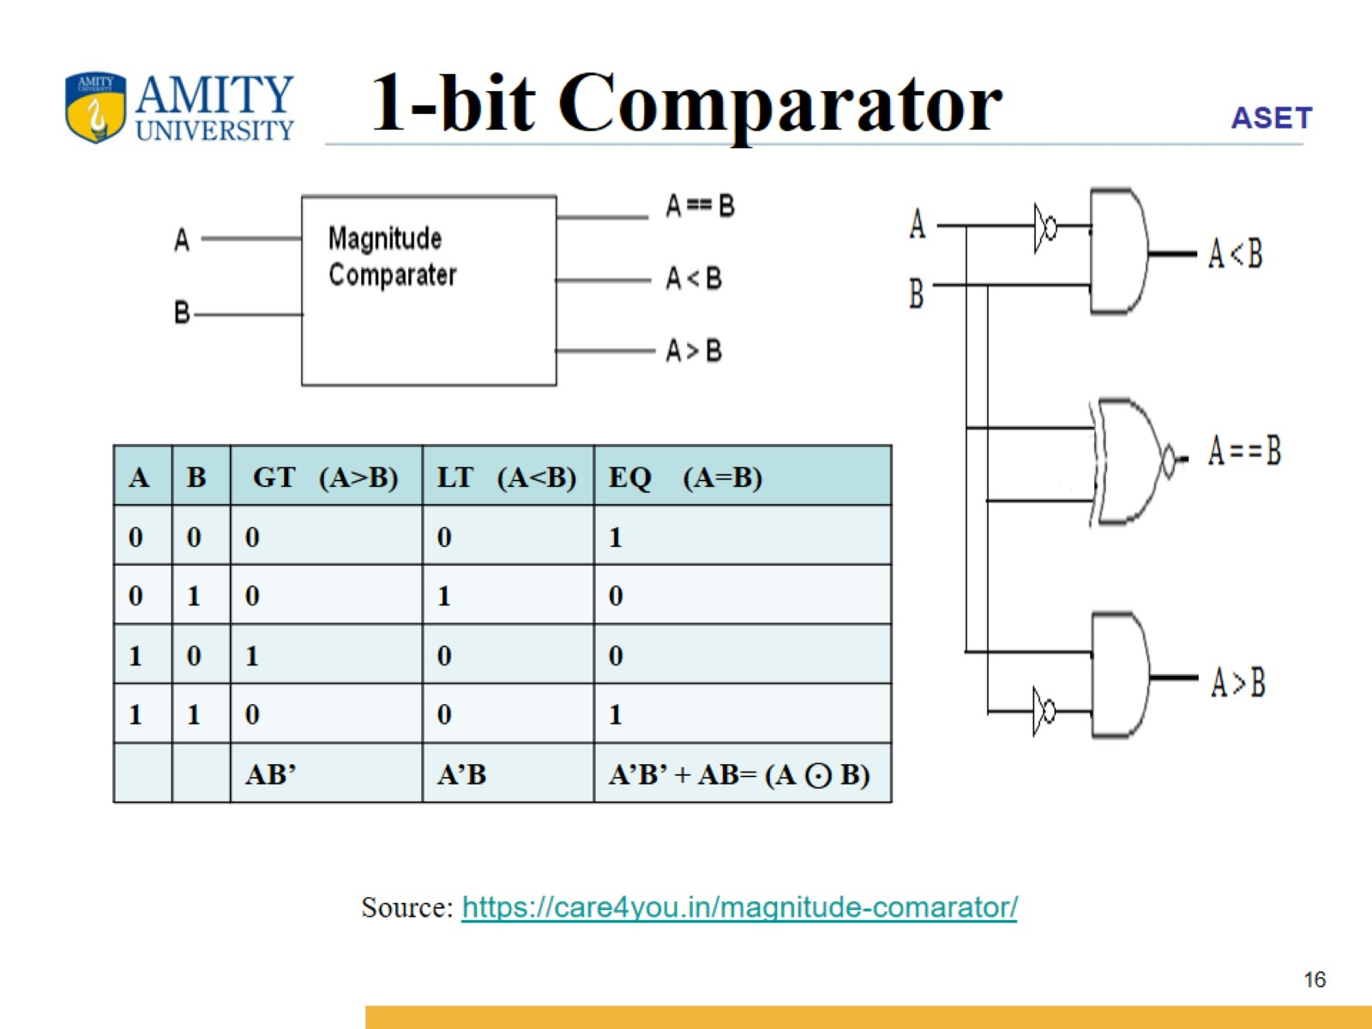
1-bit Comparator

Slide 17
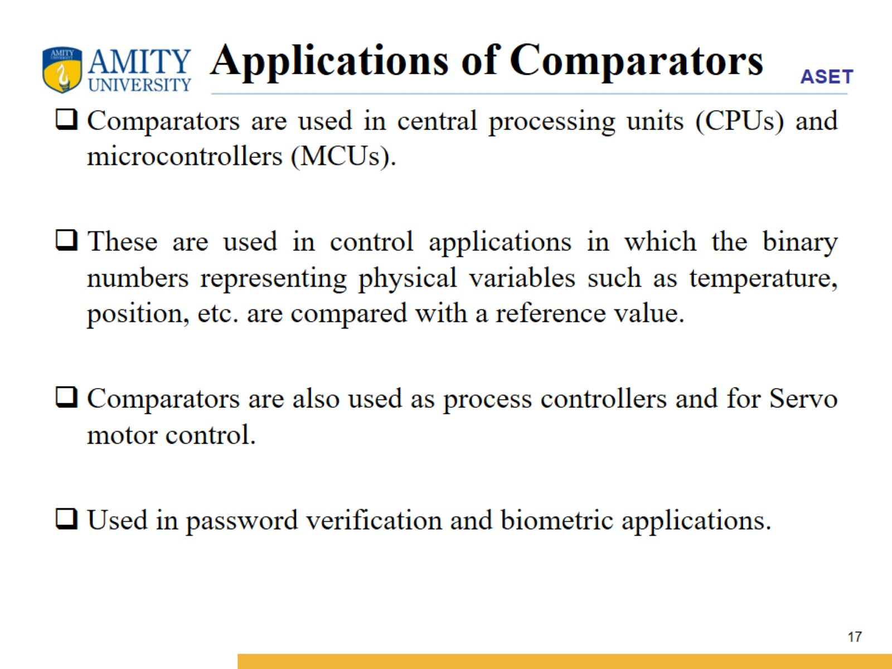
Applications of Comparators

Slide 18
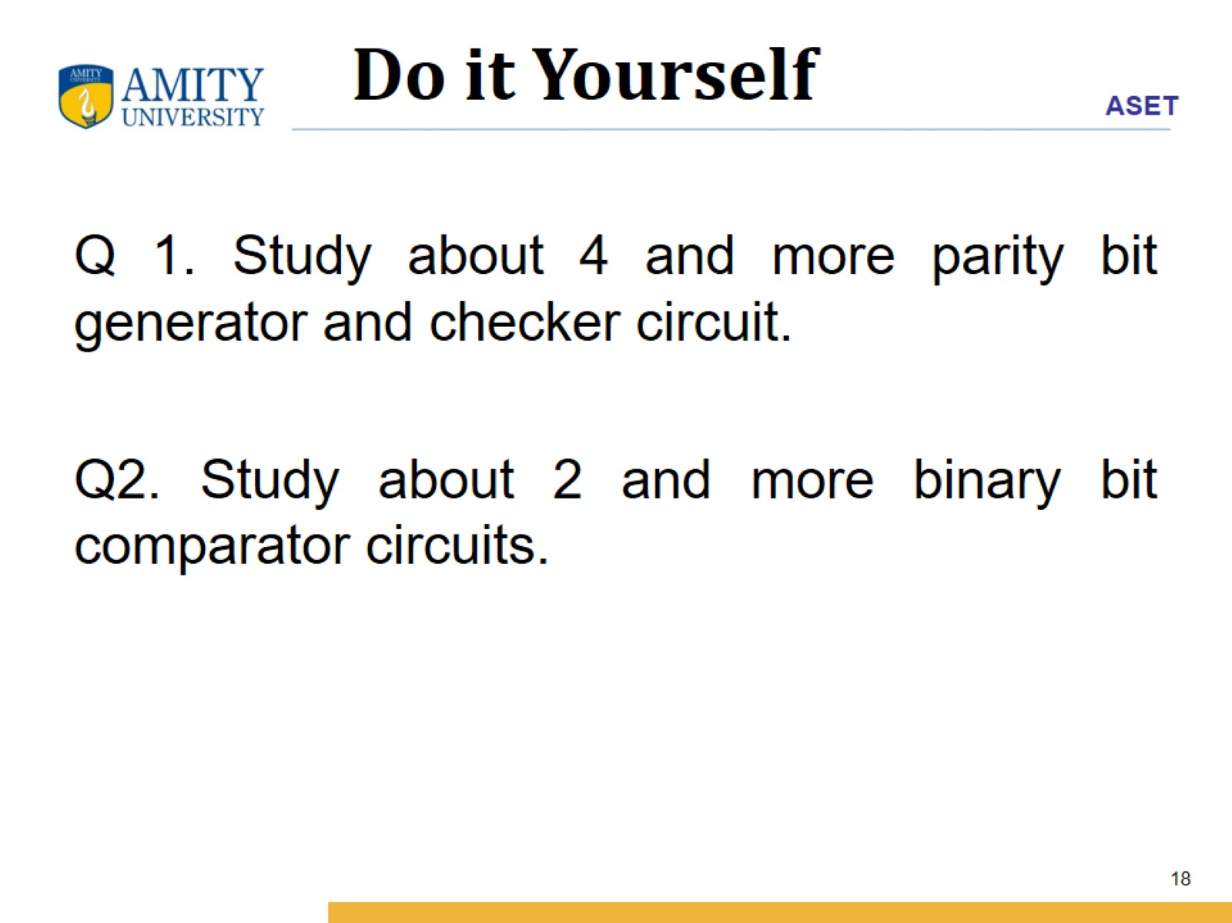

Slide 19
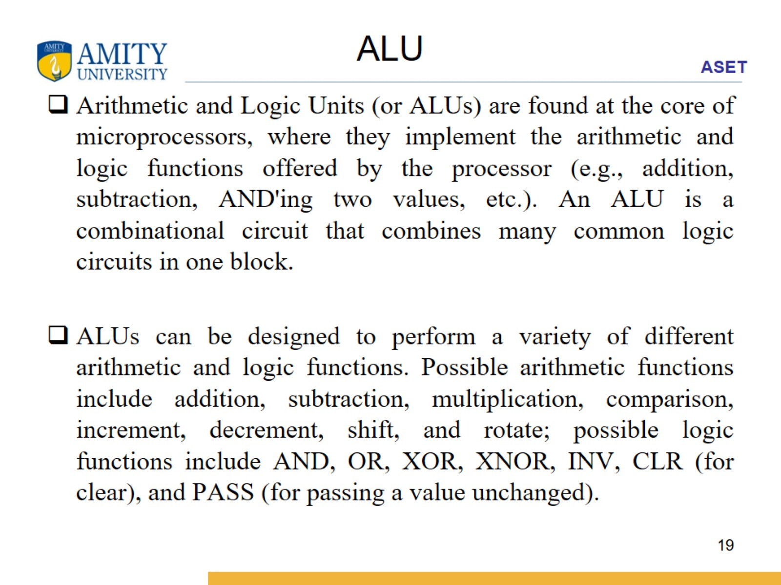
ALU

Slide 20
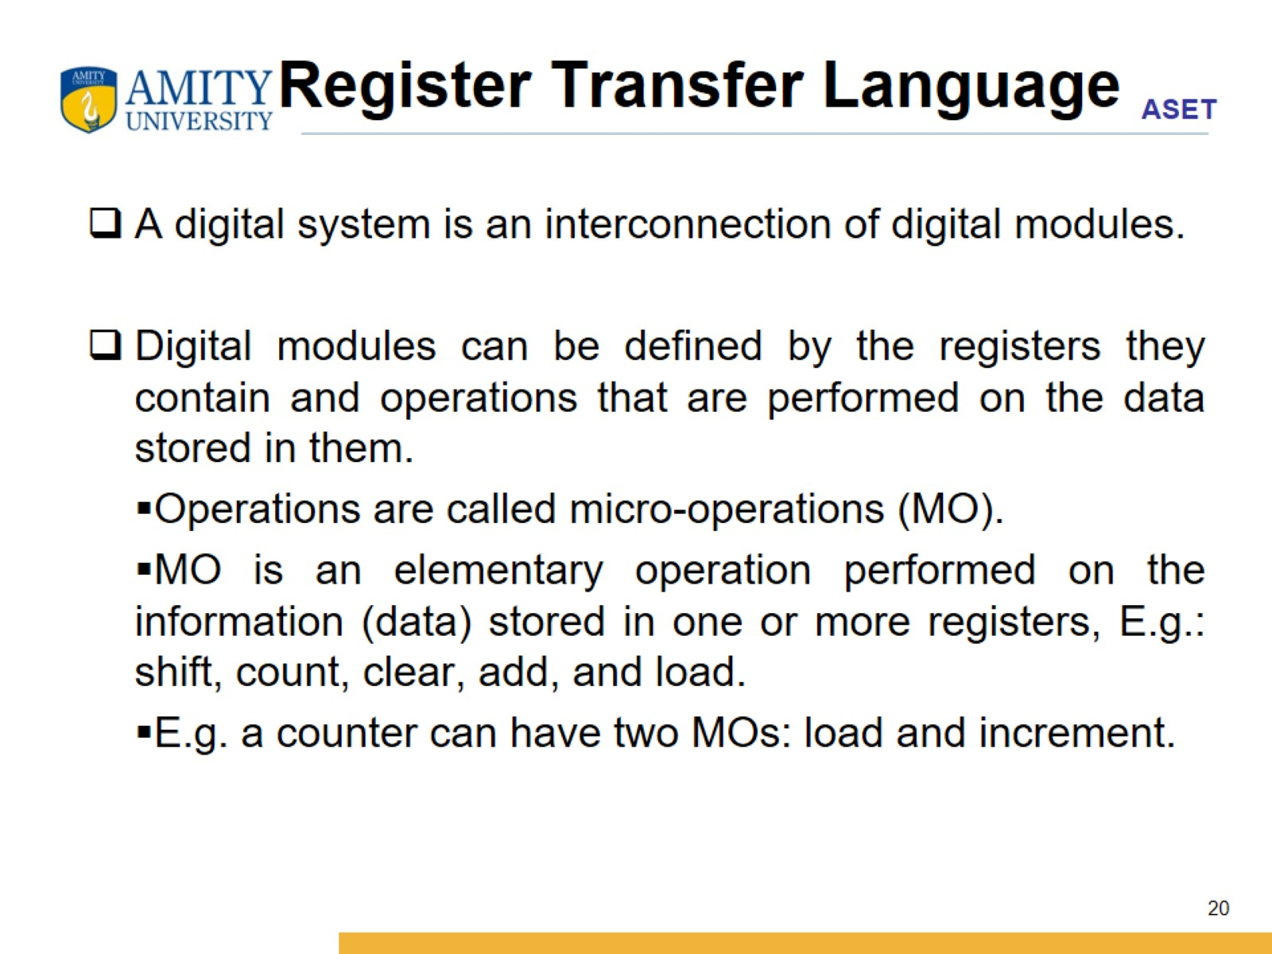
Register Transfer Language

Slide 21
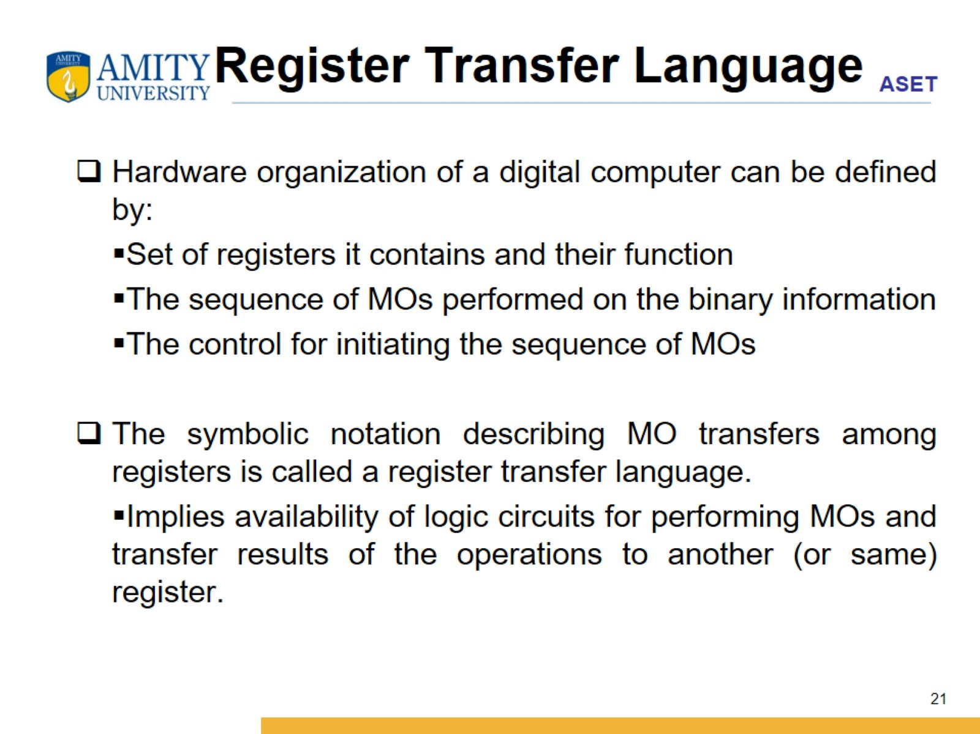
Register Transfer Language

Slide 22
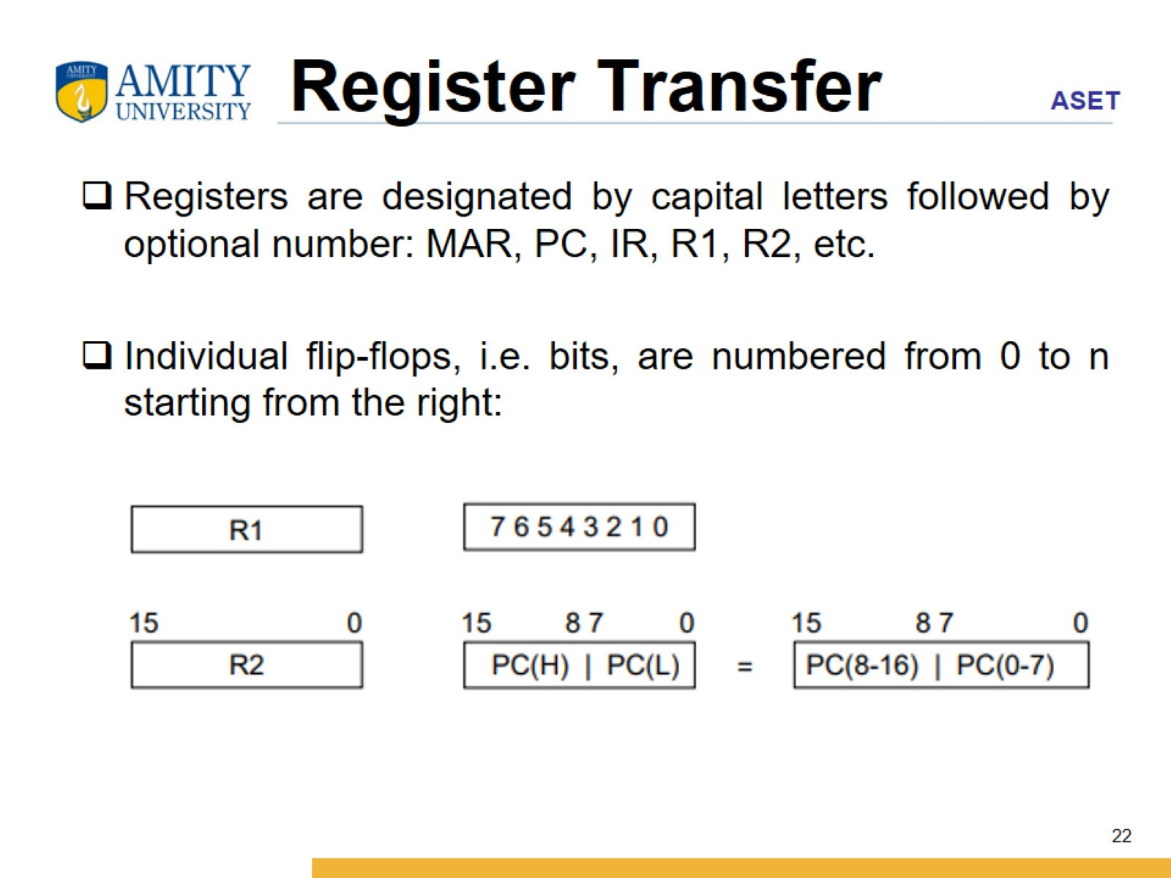
Register Transfer

Slide 23
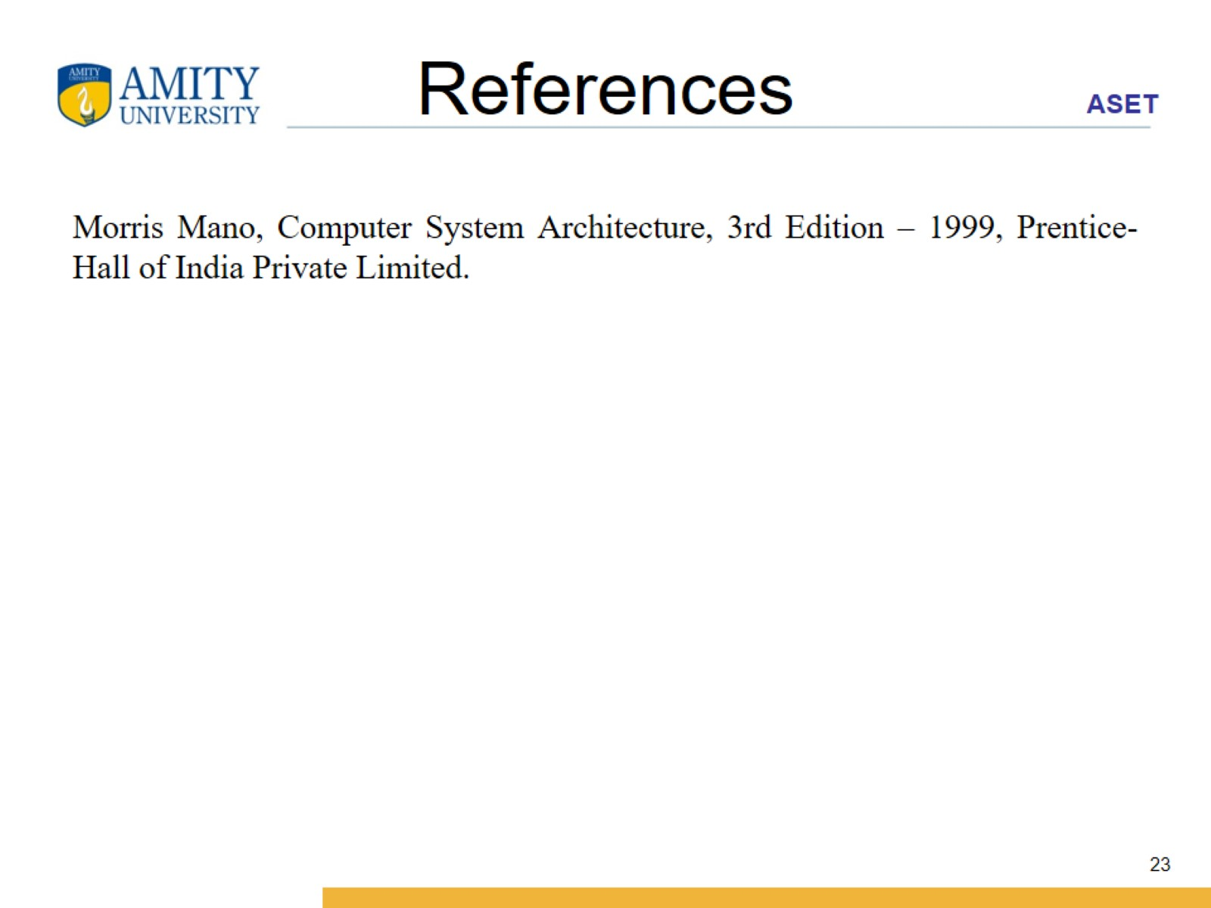
References

